Slide 1
Enterprise Anatomy: A Strategic Approach to Problem Solving

Slide 2

Introduction to Strategic Problem-Solving Through Enterprise Anatomy
In any organization, problems are inevitable. However, the approach taken to address these problems can determine whether solutions are merely temporary fixes or lead to long-term success.
The Enterprise Anatomy model, grounded in the principle of "One Enterprise, One Anatomy," offers a revolutionary approach to problem-solving that delves deep into the core of organizational challenges. This blog explores how the Enterprise Anatomy model provides a more holistic framework, compared to traditional approaches, by revealing insights that are often missed in conventional problem analysis.

Slide 3

Understanding Enterprise Anatomy: Project, Department, and Enterprise Versions
The Enterprise Anatomy model is versatile and can be applied at different levels within an organization, depending on the scope and focus:
1)Enterprise Anatomy (Project Version): This version of the model is designed to manage and streamline individual projects. It integrates key elements like strategy, process flow, system logic, component specifications, implementation, and operations. By applying this model, organizations can enhance decision-making, efficiency, and adaptability, leading to successful project outcomes.
2)Enterprise Anatomy (Department Version): When applied at the departmental level, the Enterprise Anatomy model ensures that departmental goals align with enterprise objectives. It integrates strategy, process flow, system logic, component specifications, implementation, and operations within a department, optimizing these elements to contribute to overall organizational success.

Slide 4
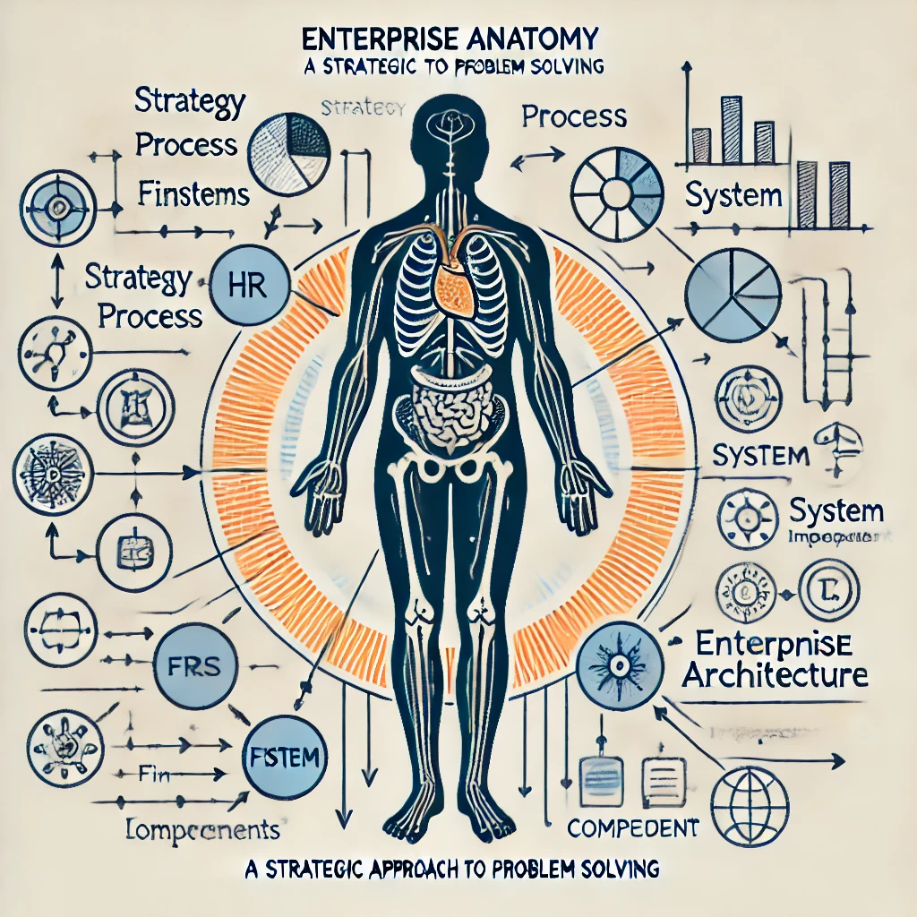
3)Enterprise Anatomy (Enterprise Version): At the enterprise level, this version of the model integrates the anatomy across all departments, ensuring alignment and optimization. It encompasses strategy, process flow, system logic, component specifications, implementation, and operations across the entire organization. This facilitates cohesive management and strategic alignment, leading to improved performance and long-term success.

Slide 5

How This Approach is a Breakthrough Compared to Traditional Frameworks
Most organizations, unfamiliar with the Enterprise Anatomy model, typically conduct only a Stage 1 analysis. This stage involves broadly defining problem statements and impacts, often focusing on the immediate, surface-level issues without realizing the existence of deeper, interconnected perspectives.
It’s akin to someone noticing pain in their toe and treating it as an isolated issue—perhaps assuming it’s due to a stub or an uncomfortable shoe. However, a doctor, understanding the body’s full anatomy, knows that such pain could be connected to a nerve issue in the hip or lower back. Without this deeper insight, the treatment might miss the real cause and fail to provide lasting relief.
Similarly, while Stage 1 analysis provides a general overview, it lacks the depth required to fully understand the root causes and broader implications of the problem.
The Enterprise Anatomy model, however, is like the breakthrough in medicine that came with the understanding of human anatomy. Just as doctors now consider how the circulatory, nervous, and immune systems interact before diagnosing and treating a condition, the Enterprise Anatomy model goes beyond Stage 1 by incorporating Stage 2-7 analysis. This comprehensive approach ensures that problems are not just superficially addressed but resolved in a way that strengthens the entire enterprise.

Slide 6

Stage 2-7 Problem Analysis: A Comprehensive Diagnostic Process
The Stage 2-7 problem analysis framework serves as a deep diagnostic process, providing a thorough understanding of the issue at hand—much like how modern medicine evaluates a patient’s health by considering multiple systems and their interactions.
This comprehensive analysis not only leads to a better understanding of problems but also uncovers opportunities to correct issues at every perspective.
One of the unique strengths of the Stage 2-7 analysis is its flexibility. It can be applied to focus on a specific subfunction within a department—like Benefits & Compensation within HR—or it can be scaled to analyze issues across all departments in the enterprise.

Slide 7
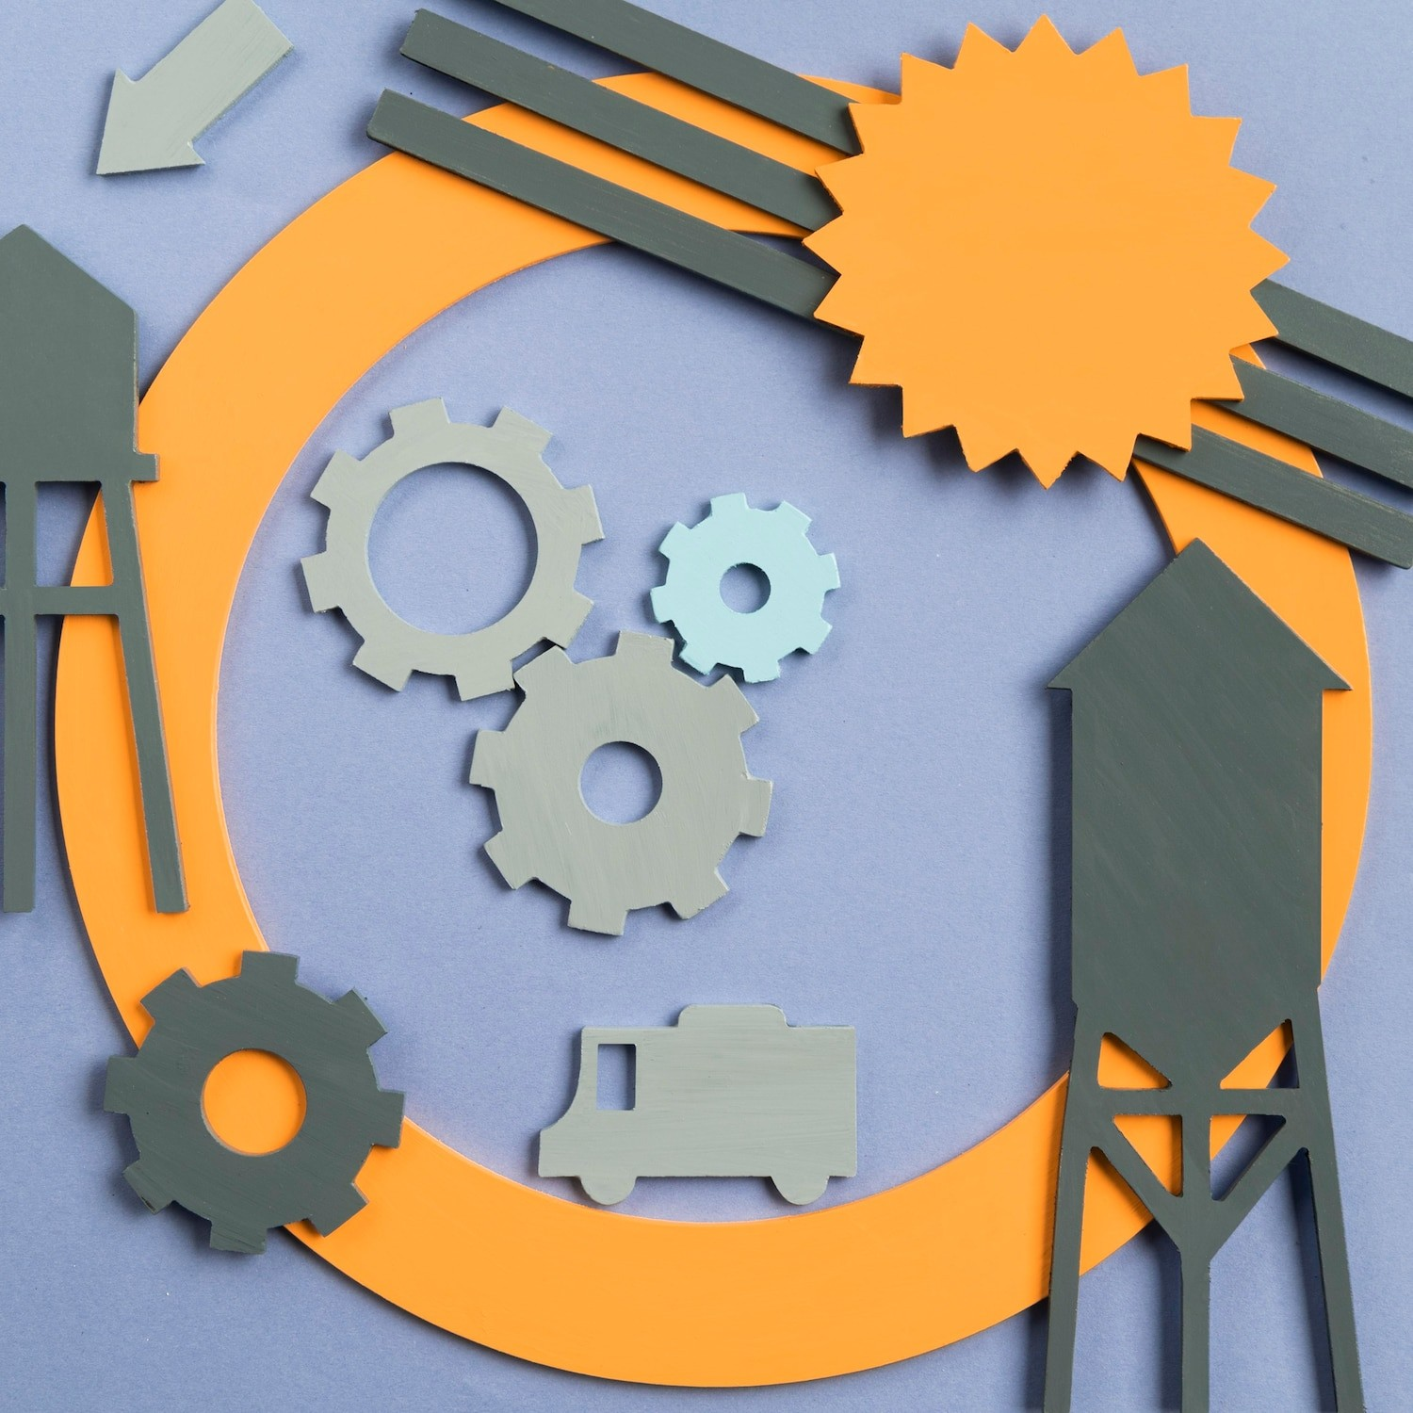
Architecture Anatomy-Driven Recommendations and Task Creation
Here's how the model supports the creation of recommendations and tasks:
1)Better Understanding of Problems: The detailed insights gained from the Stage 2-7 analysis allow for a clear understanding of the problem.
This means that recommendations are not generic but specifically tailored to address the identified issues within each perspective—strategy, process, system, and component—whether applied to a subfunction or the entire enterprise.
2)Opportunities for Correction: As each perspective is analyzed, the model uncovers opportunities to correct issues at every level.

Slide 8
3)Linking Recommendations to Perspectives: The recommendations generated are not standalone suggestions; they are linked to support the top four perspectives—strategy, process, system, and component. This linkage ensures that the tasks created to implement these recommendations are fully aligned with the organization’s architecture, making them more likely to succeed and support overall goals, whether at the subfunction level or across the entire enterprise.

Slide 9

Steps 1-13 Strategy Execution: Prescribing and Administering Treatment
Once the diagnosis is complete, the next step is treatment—implemented through the Steps 1-13 strategy execution model. This model is akin to a comprehensive treatment plan that not only addresses the current symptoms but also ensures long-term health and resilience.
Depending on whether we are discussing a project, department, or enterprise, the analogy adjusts accordingly.

Slide 10
Thank You

